Slide 1
Outline
User authentication
  Password authentication, salt
  Challenge-response authentication protocols
  Biometrics
  Token-based authentication
Authentication in distributed systems (multi service providers/domains)
  Single sign-on, Microsoft Passport
  Trusted Intermediaries
Notes:
Authentication: reliably verifying the identity

Slide 2
Password authentication
Basic idea
  User has a secret password
  System checks password to authenticate user
Issues
  How is password stored?
  How does system check password?
  How easy is it to guess a password?
    Difficult to keep password file secret, so best if it is hard to guess password even if you have the password file

Slide 3
Basic password scheme
User
Password file
kiwifruit
exrygbzyf
kgnosfix
ggjoklbsz
…
…
hash function

Slide 4
Basic password scheme
Hash function h : strings → strings
  Given h(password), hard to find password
  No known algorithm better than trial and error
User password stored as h(password)
When user enters password
  System computes h(password)
  Compares with entry in password file
No passwords stored on disk

Slide 5
Unix password system
Hash function is 25xDES
  25 rounds of DES-variant encryptions
Password file is publicly readable
  Other information in password file …
Any user can try “dictionary attack”
  User looks at password file
  Computes hash(word) for every word in dictionary
“Salt” makes dictionary attack harder
R.H. Morris and K. Thompson, Password security: a case history, Communications of the ACM, November 1979

Slide 6
Salt
Password line
  walt:fURfuu4.4hY0U:129:129:Belgers:/home/walt:/bin/csh
Compare
Salt
Input
Constant,
A 64-bit block of 0
Key
25x DES
Ciphertext
Plaintext
When password is set, salt is chosen randomly
12-bit salt slows dictionary attack by factor of 2¹²
Notes:
account:coded password data:uid:gid:GCOS-field:homedir:shell
Salt: 12 bits encoded in 2 bytes
Ciphertext: 11 bytes
It is much harder to infer the key than to infer the clear text.

Slide 7
Dictionary Attack – some numbers
Typical password dictionary
  1,000,000 entries of common passwords
    people's names, common pet names, and ordinary words.
  Suppose you generate and analyze 10 guesses per second
    This may be reasonable for a web site; offline is much faster
  Dictionary attack in at most 100,000 seconds = 28 hours, or 14 hours on average
If passwords were random
  Assume six-character password
    Upper- and lowercase letters, digits, 32 punctuation characters
    689,869,781,056 password combinations.
    Exhaustive search requires 1,093 years on average

Slide 8
Outline
User authentication
  Password authentication, salt
  Challenge-response authentication protocols
  Biometrics
  Token-based authentication
Authentication in distributed systems (multi service providers/domains)
  Single sign-on, Microsoft Passport
  Trusted Intermediaries
Notes:
Authentication: reliably verifying the identity

Slide 9



Challenge-response Authentication
Goal: Bob wants Alice to “prove” her identity to him
Protocol ap1.0: Alice says “I am Alice”
“I am Alice”
Failure scenario??

Slide 10
Authentication
Goal: Bob wants Alice to “prove” her identity to him
Protocol ap1.0: Alice says “I am Alice”
in a network,
Bob can not “see” Alice, so Trudy simply declares
herself to be Alice
“I am Alice”

Slide 11
Authentication: another try
Protocol ap2.0: Alice says “I am Alice” in an IP packet
containing her source IP address
Alice’s
IP address
“I am Alice”
Failure scenario??

Slide 12
Authentication: another try
Protocol ap2.0: Alice says “I am Alice” in an IP packet
containing her source IP address
Trudy can create
a packet “spoofing”
Alice’s address
Alice’s
IP address
“I am Alice”

Slide 13
Authentication: another try
Protocol ap3.0: Alice says “I am Alice” and sends her
secret password to “prove” it.
Alice’s
IP addr
Alice’s
password
“I’m Alice”
Failure scenario??
Alice’s
IP addr
OK

Slide 14

Authentication: another try
Protocol ap3.0: Alice says “I am Alice” and sends her
secret password to “prove” it.
Alice’s
IP addr
Alice’s
password
“I’m Alice”
playback attack: Trudy records Alice’s packet
and later
plays it back to Bob
Alice’s
IP addr
OK
Alice’s
IP addr
Alice’s
password
“I’m Alice”

Slide 15
Authentication: yet another try
Protocol ap3.1: Alice says “I am Alice” and sends her
encrypted secret password to “prove” it.
Alice’s
IP addr
encrypted
password
“I’m Alice”
Failure scenario??
Alice’s
IP addr
OK

Slide 16
Authentication: another try
Protocol ap3.1: Alice says “I am Alice” and sends her
encrypted secret password to “prove” it.
Alice’s
IP addr
encryppted
password
“I’m Alice”
record
and
playback
still works!
Alice’s
IP addr
OK
Alice’s
IP addr
encrypted
password
“I’m Alice”

Slide 17
Authentication: yet another try
Goal: avoid playback attack
Nonce: number (R) used only once –in-a-lifetime
ap4.0: to prove Alice “live”, Bob sends Alice nonce, R. Alice
must return R, encrypted with shared secret key
“I am Alice”
R
K (R)
Alice is live, and only Alice knows key to encrypt nonce, so it must be Alice!
A-B
Failures, drawbacks?
Notes:
Masquerade attack? No, unless A and B want to communicate simulatenously.

Slide 18
Authentication: ap5.0
ap4.0 doesn’t protect against server database reading
can we authenticate using public key techniques?
ap5.0: use nonce, public key cryptography
“I am Alice”
Bob computes
R
+
-
-
K
(K (R)) = R
K (R)
A
A
A
and knows only Alice could have the private key, that encrypted R such that
+
-
K
(K (R)) = R
A
A

Slide 19
Outline
User authentication
  Password authentication, salt
  Challenge-response authentication protocols
  Biometrics
  Token-based authentication
Authentication in distributed systems (multi service providers/domains)
  Single sign-on, Microsoft Passport
  Trusted Intermediaries
Notes:
Authentication: reliably verifying the identity

Slide 20
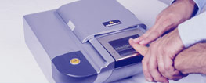

Biometrics
Use a person’s physical characteristics
  fingerprint, voice, face, keyboard timing, …
Advantages
  Cannot be disclosed, lost, forgotten
Disadvantages
  Cost, installation, maintenance
  Reliability of comparison algorithms
    False positive: Allow access to unauthorized person
    False negative: Disallow access to authorized person
  Privacy?
  If forged, how do you revoke?

Slide 21

Biometrics
Common uses
  Specialized situations, physical security
  Combine
    Multiple biometrics
    Biometric and PIN
    Biometric and token

Slide 22
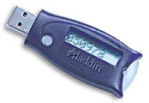
Token-based Authentication
Smart Card
With embedded CPU and memory
  Carries conversation w/ a small card reader
Various forms
  PIN protected memory card
    Enter PIN to get the password
  Cryptographic challenge/response cards
    A cryptographic key in memory
    Computer create a random challenge
    Enter PIN to encrypt/decrypt the challenge w/ the card
  Cryptographic Calculator (readerless smart card)
    Simulating a smartcard: user enter the encrypted result
Notes:
PIN protected: usually the password is much harder to memorize.

Slide 23
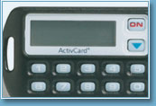
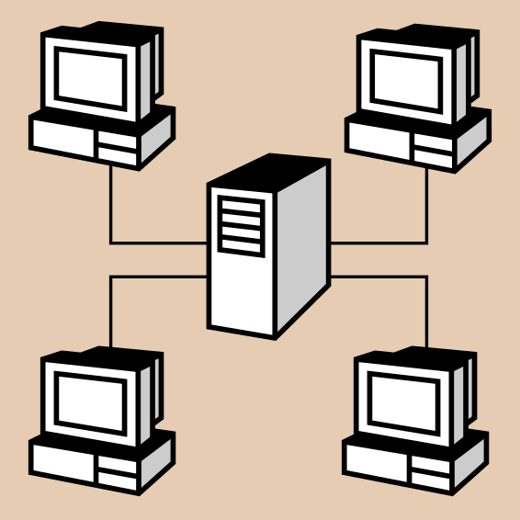
Smart Card Example
Initial data
Time
Challenge
Time
function
Some complications
  Initial data shared with server
    Need to set this up securely
    Shared database for many sites
  Clock skew

Slide 24
Outline
User authentication
  Password authentication, salt
  Challenge-Response
  Biometrics
  Token-based authentication
Authentication in distributed systems
  Single sign-on, Microsoft Passport
  Trusted Intermediaries

Slide 25
Single sign-on systems
e.g. Securant, Netegrity,
Oblix
LAN
Rules
Database
user name,
password,
other auth
Authentication
Application
Server
Advantages
  User signs on once
  No need for authentication at multiple sites, applications
  Can set central authorization policy for the enterprise

Slide 26
Microsoft Passport
Launched 1999
  Claim > 200 million accounts in 2002
  Over 3.5 billion authentications each month
Log in to many websites using one account
  Used by MS services Hotmail, MSN Messenger or MSN subscriptions; also Radio Shack, etc.
  Hotmail or MSN users automatically have Microsoft Passport accounts set up
Passport may continue to evolve; bugs have been uncovered
Notes:
www.networkmagazine.com/article/NMG20020304S0003

Slide 27
Four parts of Passport account
Passport Unique Identifier (PUID)
  Assigned to the user when he or she sets up the account
User profile, required to set up account
  Phone number or Hotmail or MSN.com e-mail address
  Also name, ZIP code, state, or country, …
Credential information
  E-mail address or phone number
  Minimum six-character password or PIN
  Four-digit security key, used for a second level of authentication on sites requiring stronger sign-in credentials
Wallet
  Passport-based application at passport.com domain
  E-commerce sites with Express Purchase function use wallet information rather than prompt the user to type in data

Slide 28
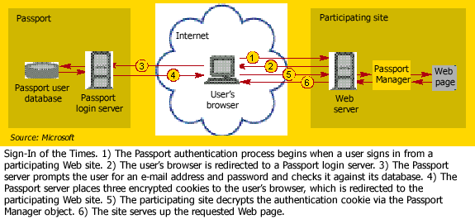
Passport log-in
Notes:
Use both symmetric and asymmetric cipher.
The Passport server encrypts the first two cookies with the unique key it shares with BuyStuff.com. Passport's own key encrypts the third cookie, which participating sites can't read.

Slide 29
Trusted Intermediaries
Symmetric key problem:
How do two entities establish shared secret key over network?
Solution:
trusted key distribution center (KDC) acting as intermediary between entities
Public key problem:
When Alice obtains Bob’s public key (from web site, e-mail, diskette), how does she know it is Bob’s public key, not Trudy’s?
Solution:
trusted certification authority (CA)

Slide 30



Key Distribution Center (KDC)
Alice, Bob need shared symmetric key.
KDC: server shares different secret key with each registered user (many users)
Alice, Bob know own symmetric keys, K_{A-KDC} K_{B-KDC} , for communicating with KDC.
KDC
K_{A-KDC}
K_{P-KDC}
K_{X-KDC}
K_{P-KDC}
K_{B-KDC}
K_{Y-KDC}
K_{Z-KDC}
K_{A-KDC}
K_{B-KDC}

Slide 31
Key Distribution Center (KDC)
Q: How does KDC allow Bob, Alice to determine shared symmetric secret key to communicate with each other?
KDC generates R1
K_{A-KDC}(A,B)
Alice
knows R1
K_{A-KDC}(R1, K_{B-KDC}(A,R1) )
Bob knows to use R1 to communicate with Alice
K_{B-KDC}(A,R1)
Alice and Bob communicate: using R1 as
session key for shared symmetric encryption
Notes:
Why not have KDC send KB-KDC(A,R1) directly to B?
KDC will have extra overhead. Easier for applications like A as well. Doesn’t have to wait for B’s reply.
Knows for sure that the key is from KDC.

Slide 32
Ticket
In K_{A-KDC}(R1, K_{B-KDC}(A,R1) ), the K_{B-KDC}(A,R1) is also known as a ticket
Comes with expiration time

Slide 33

Certification Authorities
Certification authority (CA): binds public key to particular entity, E.
E (person, router) registers its public key with CA.
  E provides “proof of identity” to CA.
  CA creates certificate binding E to its public key.
  Certificate containing E’s public key digitally signed by CA – CA says “this is E’s public key”
Bob’s
public
key
digital
signature
(encrypt)
+
K
+
B
K
B
CA
private
key
certificate for Bob’s public key, signed by CA
Bob’s
identifying information
-
K
CA

Slide 34
Certification Authorities
When Alice wants Bob’s public key:
  gets Bob’s certificate (Bob or elsewhere).
  apply CA’s public key to Bob’s certificate, get Bob’s public key
+
digital
signature
(decrypt)
Bob’s
public
key
K
B
+
K
B
CA
public
key
+
K
CA

Slide 35
Single KDC/CA
Problems
  Single administration trusted by all principals
  Single point of failure
  Scalability
Solutions: break into multiple domains
  Each domain has a trusted administration

Slide 36
Multiple KDC/CA Domains
Secret keys:
KDCs share pairwise key
topology of KDC: tree with shortcuts
Public keys:
cross-certification of CAs
example: Alice with CA_{A}, Boris with CA_{B}
  Alice gets CA_{B}’s certificate (public key p₁), signed by CA_{A}
  Alice gets Boris’ certificate (its public key p₂), signed by CA_{B} (p₁)

Slide 37
Backup Slides

Slide 38
Advantages of salt
Without salt
  Same hash functions on all machines
    Compute hash of all common strings once
    Compare hash file with all known password files
With salt
  One password hashed 2¹² different ways
    Precompute hash file?
      Need much larger file to cover all common strings
    Dictionary attack on known password file
      For each salt found in file, try all common strings

